Slide 1
The Programming Thought Process
Overview
Why “teaching a PTP”?
Programming Skill vs. Skills
PTP at a glance
How to apply this?
Notes:
What is programming?
CS vs. IT w/r to programming
an iterative process
example

Slide 2
Why teaching a PTP?
Learning by imitating = “reinventing wheel”
Explicit-ing skills = much more efficient!
Let’s try with programming skills…

Slide 3
What are our options
Teach by
Showing problems / solutions – aka textbook
Showing how it’s done – aka Apprenticeship
Analyzing the process
Which one is the “right” one?

Slide 4
What are our options
Teach by
Showing problems / solutions – aka textbook
Showing how it’s done – aka Apprenticeship
Analyzing the process
Which one is the “right” one?
All 3 of them!
The last one is often missing though

Slide 5
Programming Skill vs. Programming Skills
What are the programming skills?

Slide 6
Programming Skill
Tracing

Slide 7
Skill #1 – Reading / Tracing / Understanding
Given a valid source
follow the execution step by step
keep track of the value of each variable
keep track of what is read / displayed
Helps you understand
How programs execute so you may be able to explain & predict their outputs
Explaining & predicting is what theories are for
It’s requisite to any of the other skills

Slide 8
Example
Problem:
Need to illustrate programming skills with programs
We do not know any language yet...
Solution
Start with a very simple program
Have the core of the program rely on nothing more than K12 math; arithmetics
Not trying to teach Raptor or Programming yet; just illustrating what each of the programming skills mean

Slide 9
Example Program
Read input data from user
Store it in 2 variables named x & y

Slide 10
Example Program
Read input data from user
Store it in 2 variables named x & y
Display contents of variable named
result

Slide 11
Example Program
Read input data from user
Store it in 2 variables named x & y
Store computed value in
variable named result
Display contents of variable named
result

Slide 12
Example Program
The part that interests us:
X + Y * 5

Slide 13
Let us Trace this program
Program starts here

Slide 14
Let us Trace this program
What happens
on screen & in Memory?

Slide 15
Let us Trace this program
What happens on screen?
Enter value
for X
5

Slide 16
Let us Trace this program
1
2
3
4
5
6
What happens in Memory?
Line Executed | X
1 | 5
Enter value
for X
5

Slide 17
Let us Trace this program
1
2
3
4
5
6
Line # | X | Y
2 | 5
3 |  | 10
Enter value
for Y
10

Slide 18
Let us Trace this program
Line # | X | Y
2 | 5
3 |  | 10
1
2
3
4
5
6
result is assigned X + Y * 5

Slide 19
Let us Trace this program
X + Y * 5
Line # | X | Y
2 | 5
3 |  | 10
1
2
3
4
5
6
X + 10 * 5
X + 50
5 + 50
result is assigned
55

Slide 20
Let us Trace this program
1
2
3
4
5
6
Line # | X | Y | result
2 | 5
3 |  | 10
4 |  |  | 55
result is assigned
55

Slide 21
Let us Trace this program
1
2
3
4
5
6
Line # | X | Y | result
2 | 5
3 |  | 10
4 |  |  | 55
55

Slide 22
Let us Trace this program
1
2
3
4
5
6
Line # | X | Y | result
2 | 5
3 |  | 10
4 |  |  | 55
55
Program stops here

Slide 23
Advice on Tracing
Be extremely rigorous
Do not “narrate” what you think the program ought to do
Instead, follow scrupulously each statement based on what you know they are doing

Slide 24
Programming Skill
Implementing

Slide 25
Skill #2 - Implementing
Based on Requirements…
Write a Program which reads two integers from the user, add them up, multiply them by 5, and display the result
…we design a step-by-step solution…
Read integer value from user
Store it in variable X
Read integer value from user
Store it in variable Y
Store X + Y * 5 in variable result
Display variable result
Then we implement it

Slide 26
Skill #2 - Implementing
…we design a step-by-step solution…
Read integer value from user
Store it in variable X
Read integer value from user
Store it in variable Y
Store X + Y * 5 in variable result
Display variable result
…then implement it

Slide 27
Advice on implementing
Follow scrupulously the pseudo-code or design
Match the right language construct to what it tells you to do
Based on what you know the constructs are doing

Slide 28
Programming Skill
Testing

Slide 29
Skill #3 – Testing
When is a program done?
When it builds?
When it runs on one sample input?
When it runs on 50 sample input?
What do I use as “sample input”?
Do I make them up as I play with the program or use always the same ones
Do I make sure they cover all possible situations
Do I make sure they are as small as possible

Slide 30
Skill #3 – Testing
So testing is art in & by itself!
Tests are also used to…
Express requirements in formal terms
Make sure all paths of your programs are tested
Record previous bugs so we do not trigger them again
Anticipate potential bugs, e.g. off by one / division by 0
Tests may be…
Written on paper – not professional ;P
Implemented in “unit tests”

Slide 31
What were the requirements for our Program?
Requirements
Write a Program which reads two integers from the user, add them up, multiply them by 5, and display the result

Slide 32
How do we test this?
Requirements
Write a Program which reads two integers from the user, add them up, multiply them by 5, and display the result
Prepare tests based on requirements
Input Values |  | Program’s Output
X | Y | Expected | Observed
5 | 10 | 75

Slide 33
How do we test this?
Requirements
Write a Program which reads two integers from the user, add them up, multiply them by 5, and display the result
Run program on these tests
Input Values |  | Program’s Output
X | Y | Expected | Observed
5 | 10 | 75 | 55

Slide 34
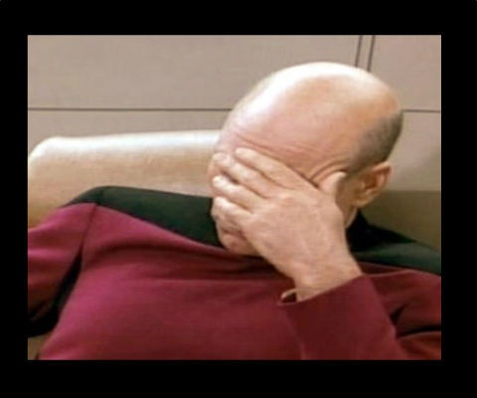
How do we test this?
Input Values |  | Program’s Output
X | Y | Expected | Observed
5 | 10 | 75 | 55
Make sure that your programs do what you think they do when you write them ;p
Notes:
Image from http://memecenter.com/

Slide 35
Advice on Testing
Test boundary values
If a value may be in [x:y] then test
{ x-1, x, y, y+1 }
Test all execution paths
If there is different ways to execute your
program then have at least one test for each
Test for likely bugs
E.g. if you divide by a variable n then make sure n is never 0
More on this
starting with
[102]

Slide 36
Programming Skill
Debugging

Slide 37
Skill #4 – Debugging
When your tests have a difference between
Expected vs. Observed results
You need to
Identify the part of the source responsible
Understand why it is doing what it’s doing instead of what you planned
Formulate a new hypothesis on how to modify it to better suit your goals
Implement it
Test it & debug again if needed

Slide 38
Identify the part of the program responsible
Input Values |  | Program’s Output
X | Y | Expected | Observed
5 | 10 | 75 | 55
Use tracing to do so

Slide 39
Understand what happens
Input Values |  | Program’s Output
X | Y | Expected | Observed
5 | 10 | 75 | 55
Based on what you learned in lectures / readings
Operators have precedence
So * is evaluated before +

Slide 40
Make hypothesis on how to fix it, implement it
Input Values |  | Program’s Output
X | Y | Expected | Observed
5 | 10 | 75 | 55
We need to play with what we know about priorities to get both variables to be *5
X * 5 + Y * 5

Slide 41
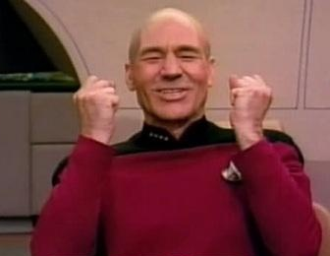
Test again!
Input Values |  | Program’s Output
X | Y | Expected | Observed
5 | 10 | 75 | 75
Success!!!
Notes:
Image from http://memecrunch.com/

Slide 42
Advice on Debugging
First, understand what is happened & why
Then only make an informed hypothesis on how to fix it
Do not succumb to “random programming” ☺

Slide 43
Programming Skill
Refactoring

Slide 44
Skill #5 – Refactoring
Rewriting same features so as to improve quality
readability / maintainability
performance
Always use regression testing when refactoring!
Run tests before / after refactoring
Make sure results are the same
Helps you understand
Alternatives’ equivalences
Rule of the game = Get it to work first, then improve!

Slide 45
Refactor this
Use what you learned in lectures / readings to improve programs

Slide 46
Refactor this
Use what you learned in lectures / readings to improve programs
Make sure the improved version still passes the tests!!!
Input Values |  | Program’s Output
X | Y | Expected | Observed
5 | 10 | 75 | 75

Slide 47
Advice on Refactoring
Know
your language constructs
their differences / similarities / tradeoffs
Do not start refactoring before you have something that works
“works” = passes enough tests to give you confidence it’s implementing all of the requirements accurately

Slide 48
Programming Skill
Designing

Slide 49
Skill #6 – Designing / Problem-Solving
You see now
Skills need to be mastered before to “write programs”
How they are necessary to design new programs
What is designing?
Take requirements with no details on how to address them, just what is desired by client
It is not the same as implementing!!!
Pick a micro-feature from requirements
Design / implement / test / debug / refactor it
Keep doing this until you are done

Slide 50
Skill #6 – Designing / Problem Solving
Implementation Question
Write a program which declares a variable “sum” of data type integer and initialize to zero. You will then read from the user an integer value and store it inside a variable “number” of data type integer. You will keep reading such a value in a loop until the user enters a negative value at which point you will end the loop. For each value you read, add it to the variable “sum”
Design Question
Write a program which displays the sum of a variable number of integers read from the user. You will let the user enter all integers to be summed consecutively until they enter a negative value.

Slide 51
Advice on Designing
Take COP3515 IT Program Design ☺
This is where we focus a bit more on this skill than the others

Slide 52
PTP at a glance
So…
What do we really do when we program?
We combine all these skills!

Slide 53
PTP made Explicit
Implement
Design
hypothesis
Test
Refactor
Extract
Tests
Extract
Features
Requirements
Write a program which keeps reading positive integers from the user (representing
grades), sums them and keeps track of how many values are entered. Please note
that the value has to be between 0 and 100 (inclusive). If the user types a negative
value, you will stop asking for values and compute the average of all positive
values provided. If the user types a value greater than 100, you will ignore it and
display an error message inviting the user to give you another value for this
particular grade.
No Thanks
I Agree

Slide 54
PTP made Explicit
Implement
Trace Problem
Design
hypothesis
Test
Extract
bugs
Design hypothesis
Refactor
Implement
Extract
Tests
Extract
Features
Requirements
What if the tests are failing though?

Slide 55
So what is this all about?
Programming is an iterative process
Making errors is part of the process!
The Programming “algorithm” ;p

Slide 56
Programming is an iterative process
It’s not about “getting it right” the 1st time
Understand what happens & know what you need
Adapt what you have & get it incrementally closer to what you need
Making errors is part of the PTP
Do not “feel bad” because you are making errors
Do not just change things randomly until the program passes the tests
Instead, understand & learn from your errors!

Slide 57
Programming is an iterative process
So Programming means…
Decide what SMALL feature you will implement next
Design your SMALL solution – a few lines only
Implement it
Make sure it implements the requirements, do not move to the next step until what you implemented works!
Rinse & repeat

Slide 58
Hold on a minute there…
It is not really an “algorithm” e.g. “design hypothesis”???
This is where programmers’ skills shine
Implement
Trace Problem
Design
hypothesis
Test
Design hypothesis
Refactor
Implement

Slide 59
Hold on a minute there…
It is not really an “algorithm” e.g. “design hypothesis”???
This is where programmers’ skills shine
This is where machines / algorithms are limited
Implement
Trace Problem
Design
hypothesis
Test
Design hypothesis
Refactor
Implement

Slide 60
Hold on a minute there…
It is not really an “algorithm” e.g. “design hypothesis”???
This is where programmers’ skills shine
This is where machines / algorithms are limited
Look at this as job safety ;P
Implement
Trace Problem
Design
hypothesis
Test
Design hypothesis
Refactor
Implement
Notes:
If you are pragmatic, look at this as job safety

Slide 61
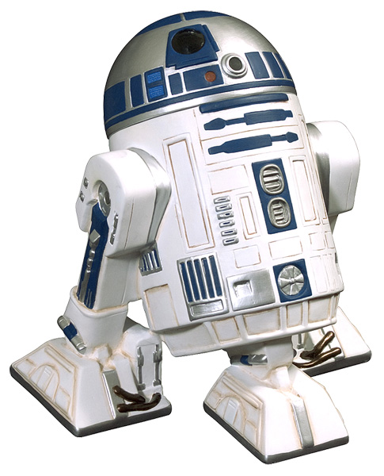
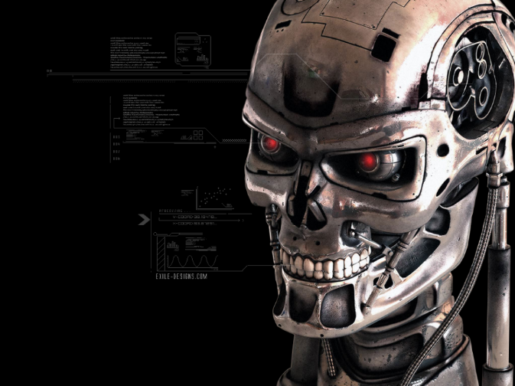
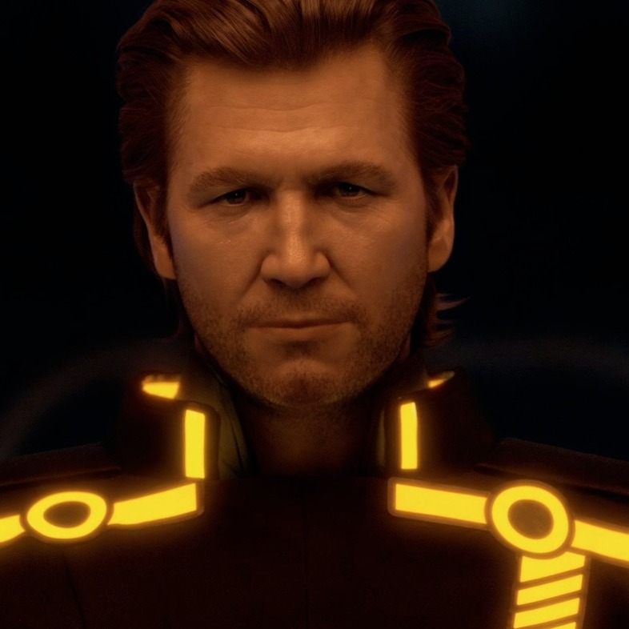
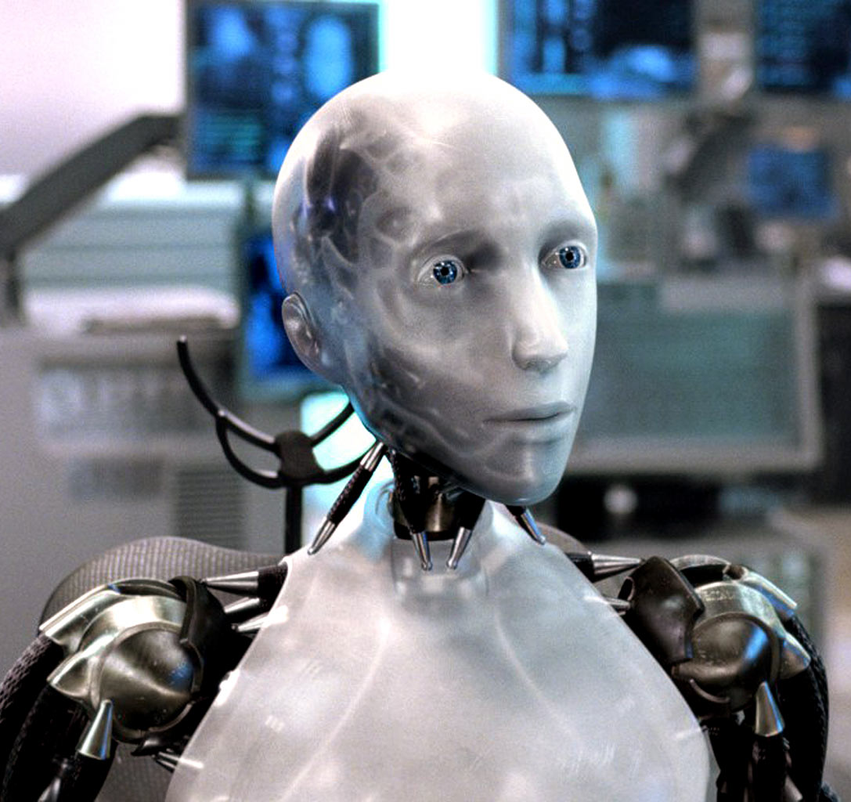
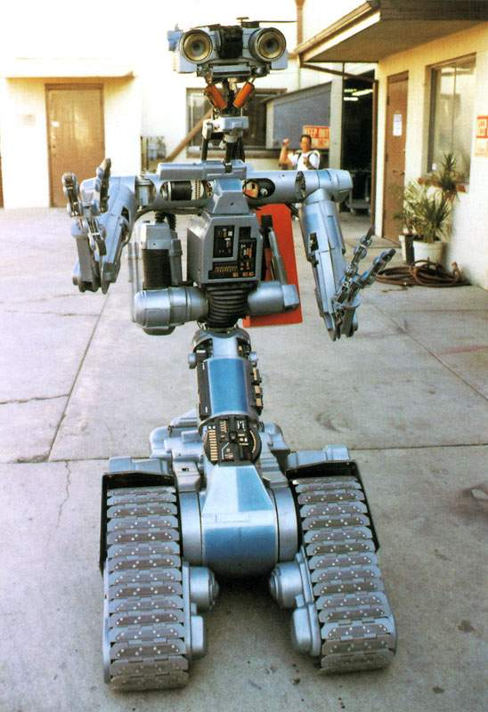
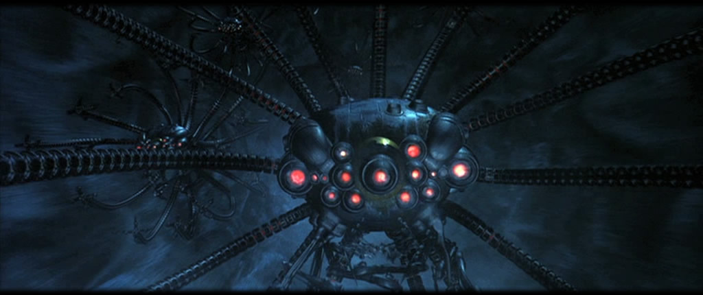
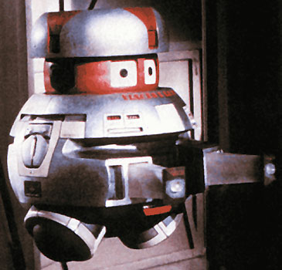
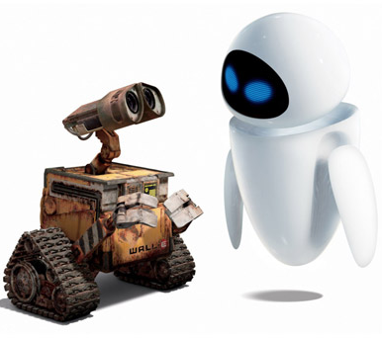
…For now ;P
Notes:
If you are into SciFy, look at this as a temporary situation ;p
Images from yahoo images ;P

Slide 62
Questions?

